Slide 1
DATABASE OF AMERICAN WINES
By,
Shah, Prachi
Adur, Kartik
PugaVaglienti, Luis
ILS-Z 636 Semantic Web/Data Semantics
Project Presentation
2014

Slide 2
Semantic Web and challenges
Data with complex semantics
Interactive websites, modern browsers and web technologies
Different formats: JSON, CSV, Text
Problem:
Data merging, changing data format
Maintaining the semantics
Human readable and machine understandable
Semantic web: promotes common data format
RDF (Resource Description Format)
Data interchange: formats change
Semantics remain the same

Slide 3
Database of American Wines
Base data format: XML
Converted to RDF data format for oneness, maintained the semantics
Output: Human-readable information about wines
Display information about wines
Backend: RDF dataset
Exhibit: MIT SIMILE widget
Frontend: HTML webpage
Facets filter data as per grapes, color and winery
Map displays a winery’s geolocation
Tabular format displays wines as a list
Currently, data display limited to a map and a list

Slide 4
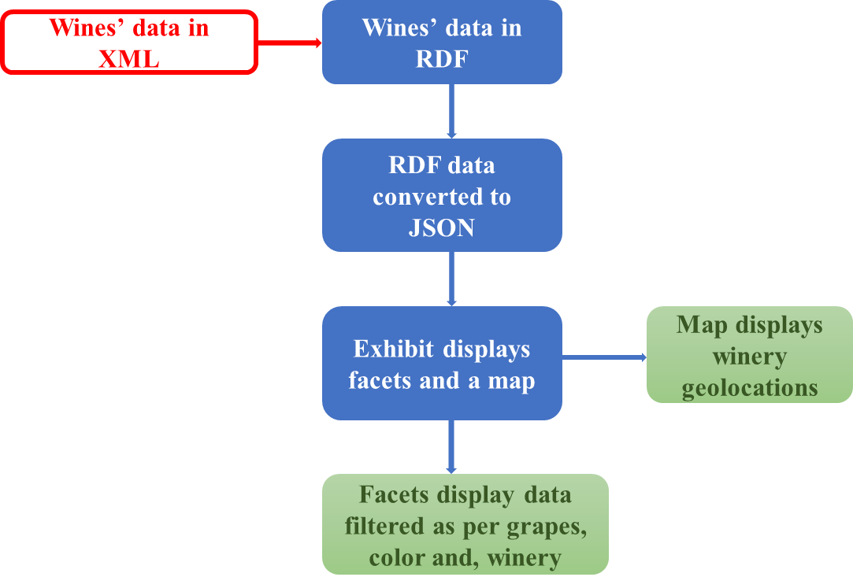
Process Model

Slide 5
Implementation
HTML webpage:
Exhibit: A reference to the Exhibit API <script src=http://trunk.simile-widgets.org/exhibit/api/exhibit-api.js type="text/javascript">
Facets: Filters data as per grapes, color or winery <div ex:role="facet" ex:expression=".madeFrom" ex:facetLabel="Grapes“>
Map: A map that displays winery geolocation (latitude and longitude) <div ex:role="view“ ex:viewClass="Map“ ex:label="Wines by Location“ ex:latlng=".producedBy.latlng“ ex:selectCoordinator="Wine">
Tabular format: <div ex:role="view" ex:viewClass="Tabular" ex:label="Details“ ex:columns=".label, .producedBy, .vintage, .hasColor, .madeFrom, .alcoholContent“ ex:columnLabels="Name, Winery, Vintage, Color, Grapes, ABV“>

Slide 6
Implementation (cont’d.)
RDF data:
Stored in an .owl file
Object properties: color, made from, produced by, produces
<owl:ObjectProperty rdf:about="&wineCollection;hasColor">
JSON: Babel converts RDF data to JSON
Facets: Filters data based on grapes, color or winery
Map: Winery geolocations (latitude and longitude)
Tabular: Data displayed as a list in a row-column format
Filter data to display one wine’s information

Slide 7
RDF Graph

Slide 8
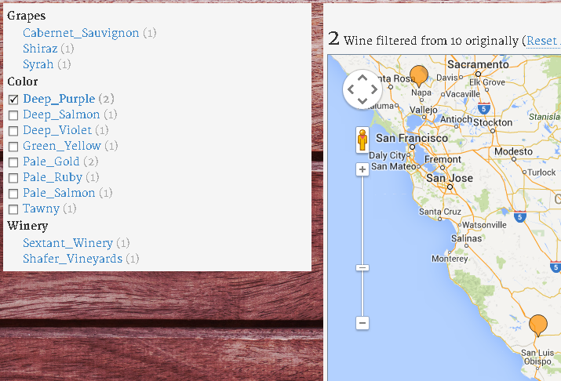
Implementation (cont’d.)
Facets:
Facets filter
data as per
grapes, color and
winery

Slide 9
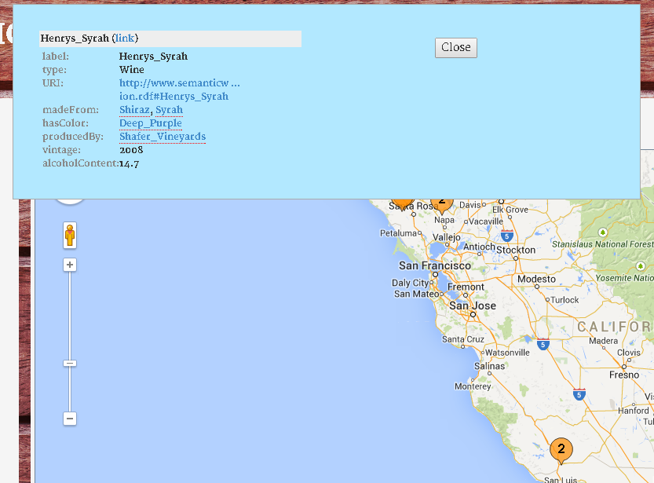
Implementation (cont’d.)
Map:
Geolocation and details
of a winery that
produces a wine
of color ‘Deep purple’

Slide 10
Questions?

